Slide 1

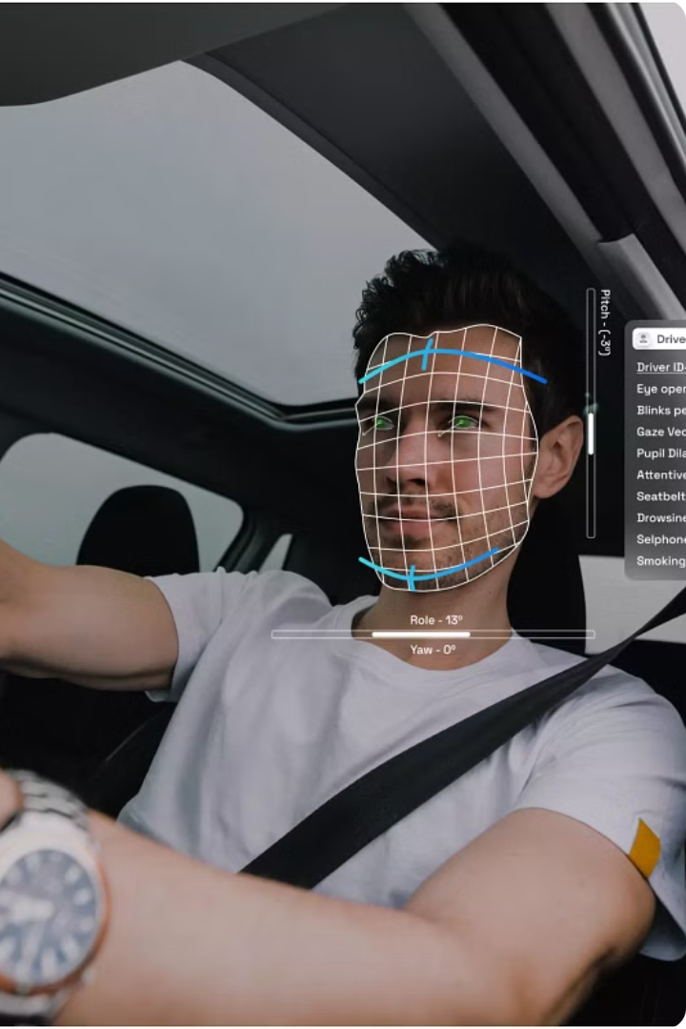
Driver Drowsiness Detection System
This presentation will explore a driver drowsiness detection system implemented in Python using OpenCV, a powerful computer vision library.
-Presented by:
Batch no:15
22R21A67B3
22R21A6790
22R21A6791

Slide 2
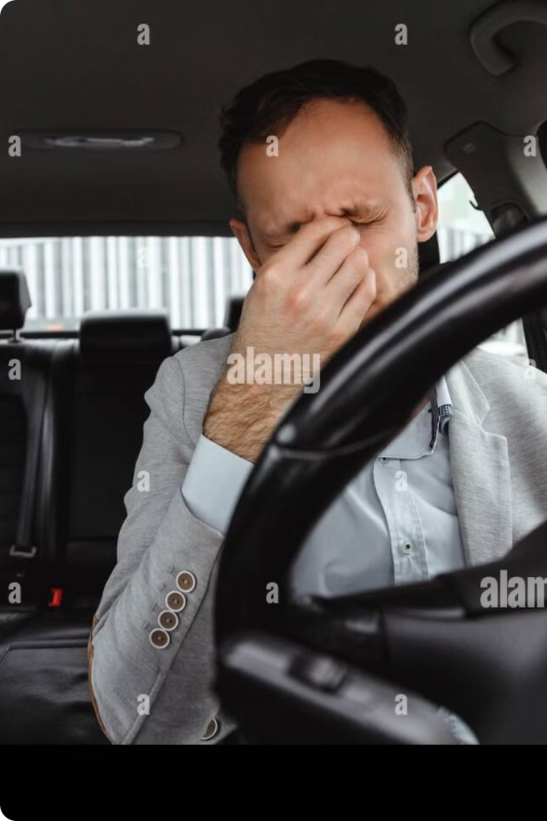
The Problem: Drowsiness and Driving Safety
Driver drowsiness is a significant contributor to traffic accidents, posing a major threat to road safety.
When drivers are fatigued, their reaction times slow down, and their ability to make safe decisions is impaired.
Drowsiness-related crashes can result in serious injuries or fatalities, highlighting the urgent need for effective countermeasures.

Slide 3



Python and OpenCV: Tools for Real-Time Analysis
Python
OpenCV
Real-Time Processing
Python's versatility and extensive libraries make it ideal for computer vision tasks. It's easy to use and allows for rapid prototyping.
OpenCV is a powerful library specifically designed for real-time computer vision. It provides a wide range of functions for image and video processing.
Combining Python and OpenCV enables real-time analysis of video streams, allowing us to detect and react to driver drowsiness in real-time.

Slide 4





System Architecture: Overview of Components
Video Capture
The system utilizes a webcam or a built-in camera to capture real-time video footage of the driver.
Image Preprocessing
The captured video frames undergo image preprocessing, which involves resizing, converting to grayscale, and applying Gaussian blur to enhance image quality.
Eye Detection
OpenCV's Haar Cascade Classifier is employed to detect the driver's eyes in each frame.
Drowsiness Detection
Using algorithms based on eye aspect ratio (EAR), the system analyzes eye movements and blink patterns to identify signs of drowsiness.
Alert System
If drowsiness is detected, an alert mechanism is triggered, notifying the driver through audible alarms, visual warnings, or vibrations.

Slide 5


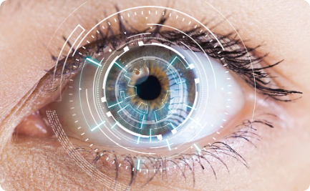
Eye Detection: Using OpenCV for Eye Tracking
OpenCV Library
Real-time Tracking
User Interface
OpenCV provides robust eye detection algorithms. The library uses Haar cascades to identify eyes in images or video streams.
OpenCV enables real-time eye tracking by processing frames from a camera or video input.
A user interface (UI) is developed to display the detected eyes and related data.

Slide 6
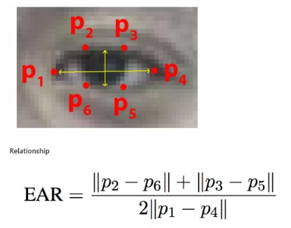
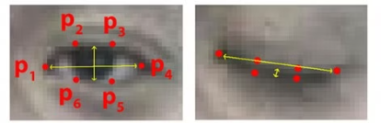
Drowsiness Detection: Algorithms and Metrics
Eye Aspect Ratio (EAR)
The eye aspect ratio (EAR) is a metric used to measure the distance between the eye's vertical and horizontal landmarks. The EAR decreases when the eyes are closed or droopy.

Slide 7




System Implementation: Code Structure and Modules
Main Script
1
Orchestrates the entire system flow.
2
Eye Detection Module
Utilizes OpenCV for real-time eye tracking.
Drowsiness Detection Module
3
Analyzes eye state and calculates drowsiness metrics.
4
Alerting Module
Triggers alerts based on drowsiness levels.
The system is modularized to ensure maintainability and flexibility. Each module focuses on a specific task, promoting clear code organization. The main script acts as the central control unit, coordinating data flow between modules and managing the overall system execution.

Slide 8
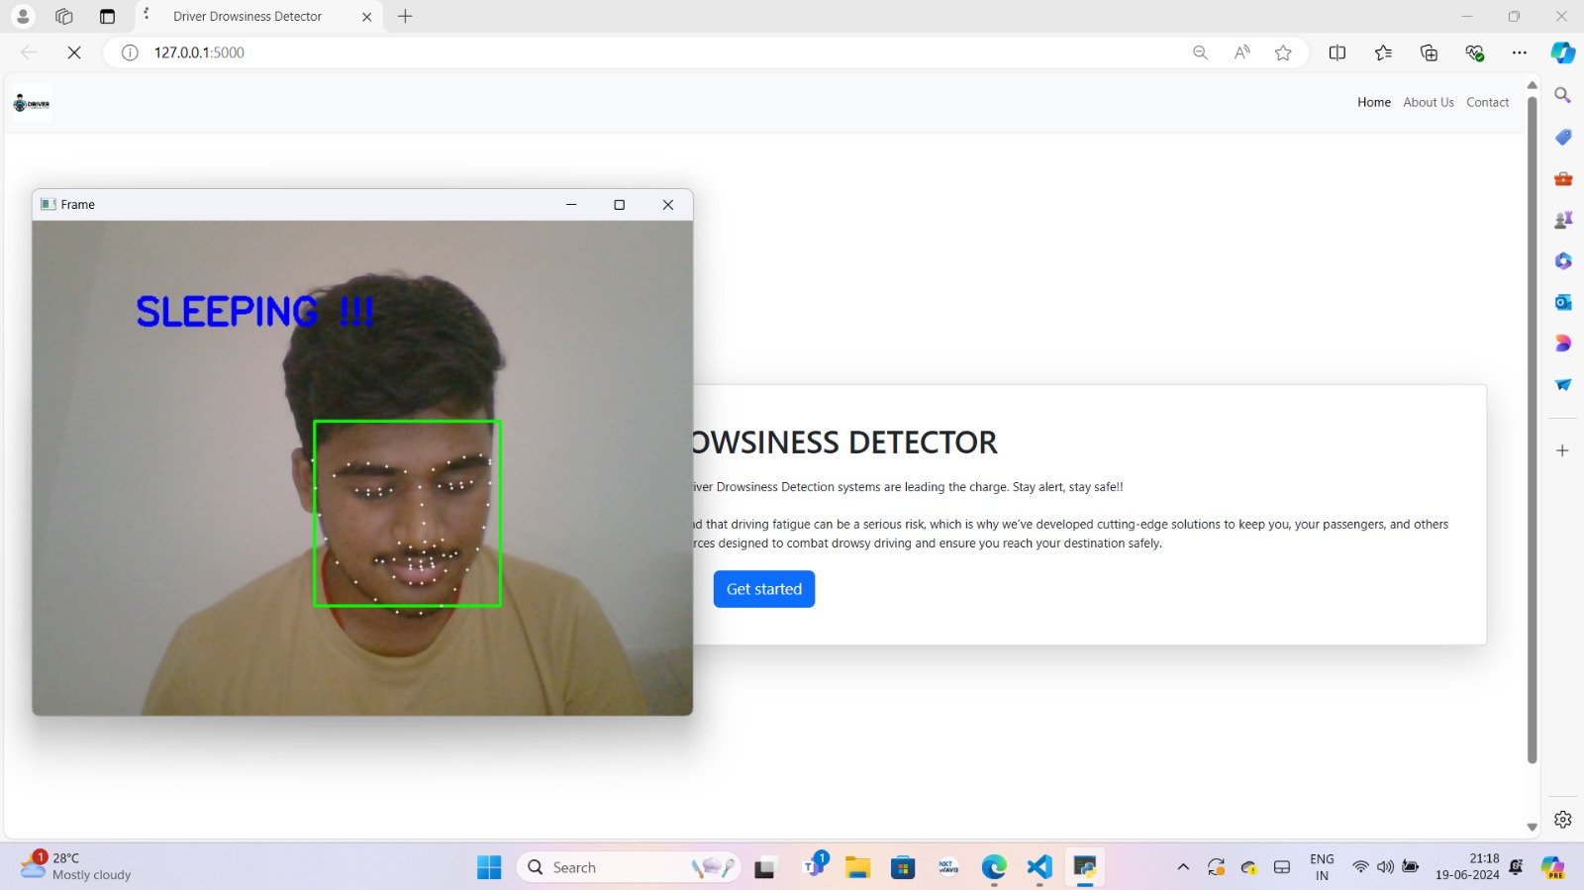
Proto-type Demonstration

Slide 9
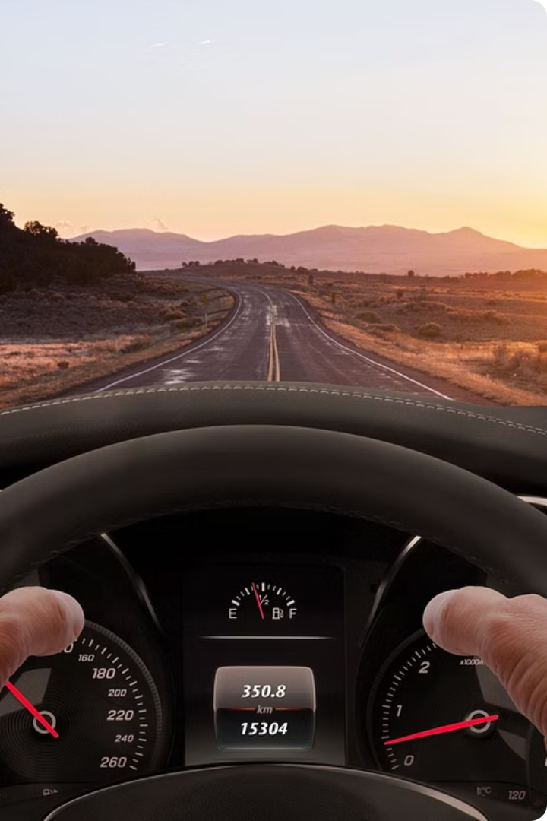
Thank You
We hope this presentation has provided you with a comprehensive overview of our driver drowsiness detection system. Thank you for your time and attention.

